Slide 1
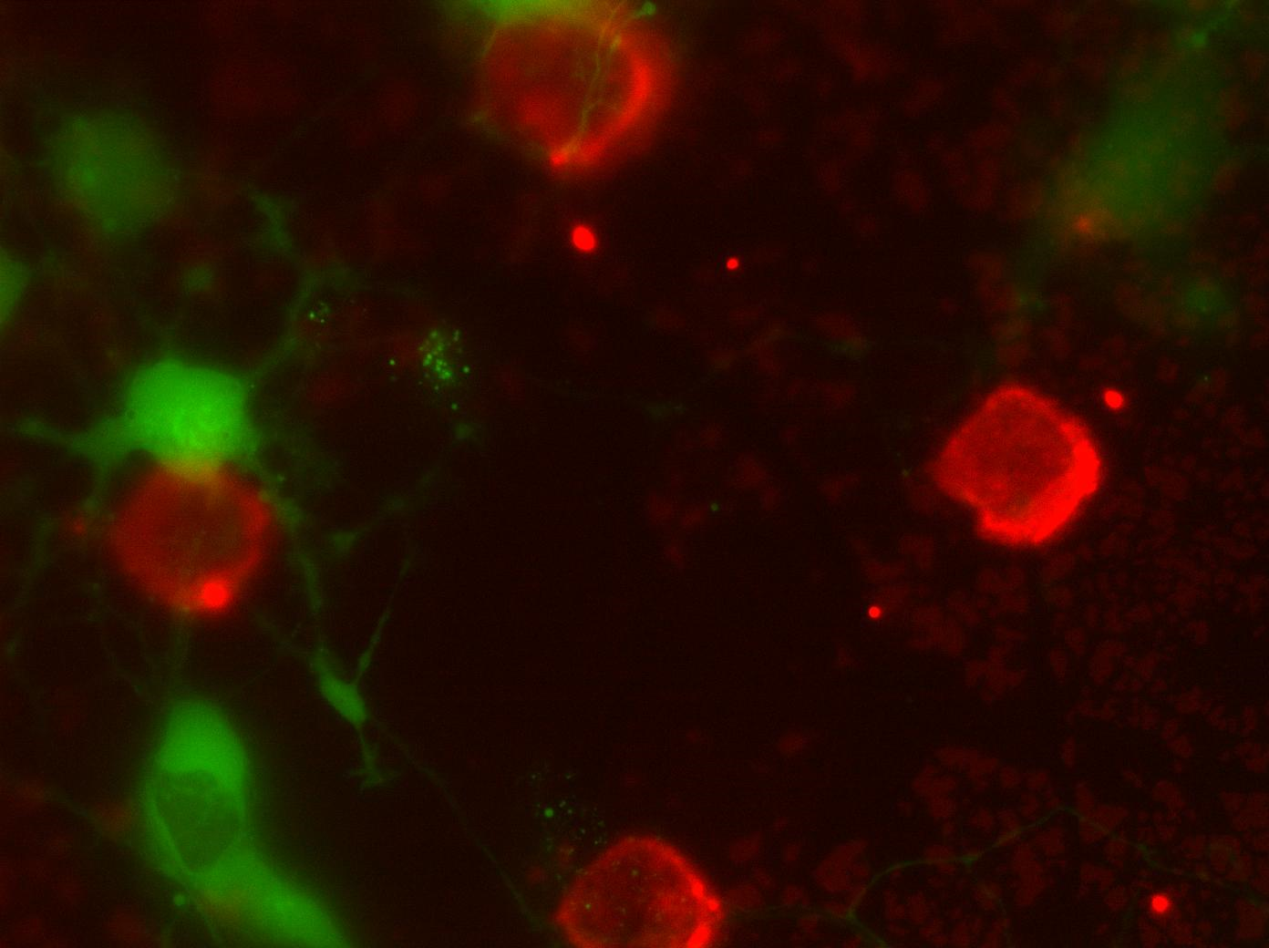
FRET and Biosensors
Kurt Thorn
Nikon Imaging Center
Image: Thomas Huckaba

Slide 2
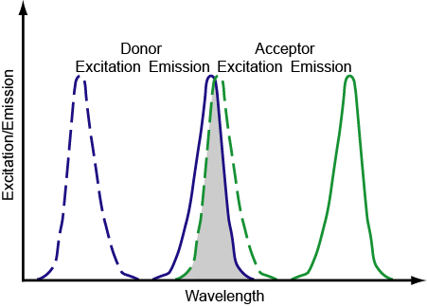
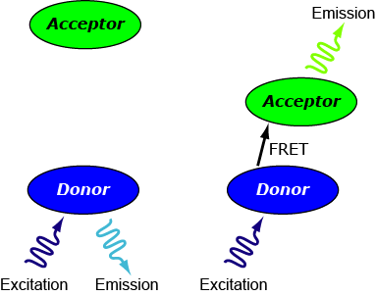
Fluorescence Resonance Energy Transfer

Slide 3
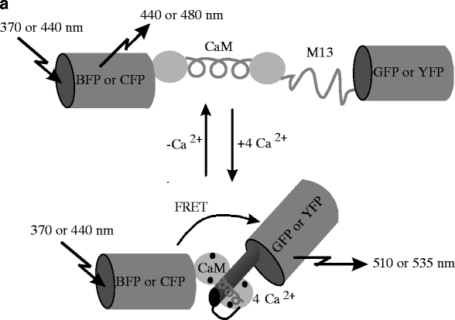
Cameleons: FRET-based Ca²⁺ sensors
Miyawaki et al. 1997. Nature 388, p882-887

Slide 4
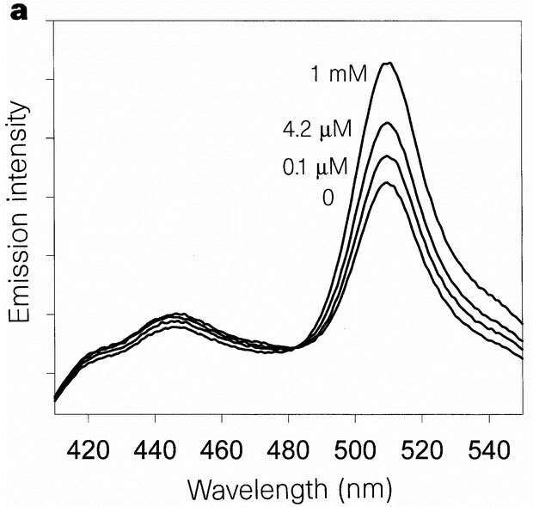
Cameleons: FRET-based Ca²⁺ sensors
Miyawaki et al. 1997. Nature 388, p882-887

Slide 5
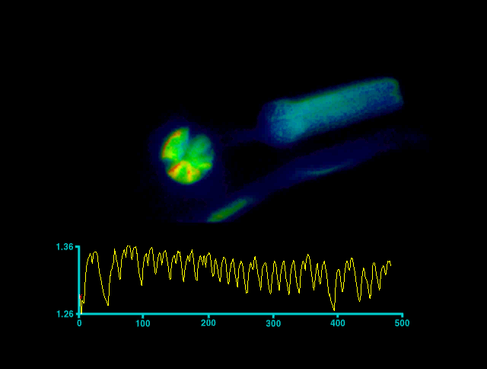
Calcium transients in C. elegans pharynx
Kerr et al. 2000. Neuron 26, p. 583-594

Slide 6
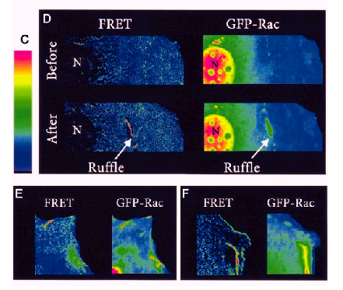
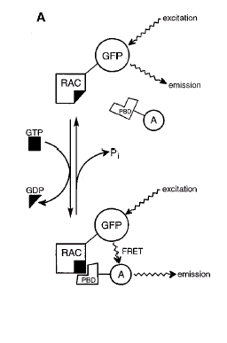
Using FRET to monitor Rac activation
Kraynov et al. 2000, Science 290: 333

Slide 7
Good FRET pairs
CFP/YFP – use A206R mutants if dimerization is problematic
GFP/mCherry, YFP/mCherry, mTFP/mKO, many other FP pairs – not so well validated
Fluorescein/Rhodamine
Cy3/Cy5 or Rhodamine/Cy5
Many other small molecule pairs

Slide 8
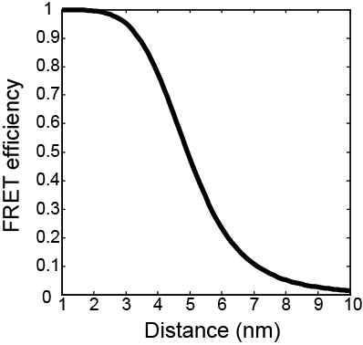
Distance dependence of FRET
1
E =
1+ (r⁶/R₀⁶)
R₀⁶ ∝ κ² n⁻⁴ Q_{D} J(λ)
Overlap between donor emission and acceptor excitation
Donor quantum yield
Refractive index
Orientation between fluorophores
For CFP-YFP,
50% transfer at R₀ = 4.9 nm

Slide 9
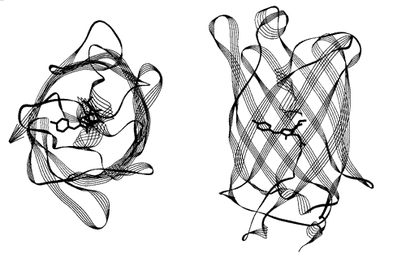
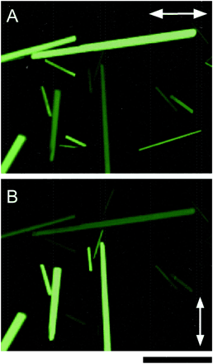
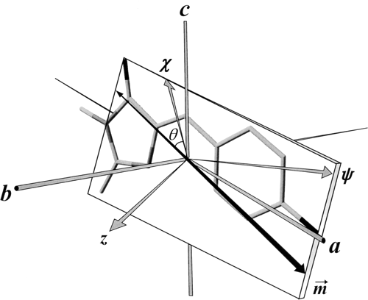
Transition dipole of GFP
Rosell and Boxer 2002; Inoue et al. 2002

Slide 10
Angular dependence of FRET
κ² depends on the relative orientations of the donor and acceptor excitation dipoles.
κ² ranges between 0 and 4 and is 0 for whenever the donor and acceptor dipoles are perpendicular to one another.
For rapidly-rotating dyes κ² = 2/3
R*⁶ ∝ n⁻⁴ Q_{D} J(λ)
1
E =
1+ (r⁶ / R*⁶κ²)

Slide 11
FRET Theory
κ² = (cos θ_{T} – 3 cos θ_{D} cos θ_{A})²
For rapidly tumbling molecules, can average over all possible orientations to give κ² = 2/3
But rotational correlation time for GFP is ~16 ns; fluorescence lifetime is ~3ns
θ_{A}
Acceptor
θ_{D}
Donor
θ_{T}
Acceptor
Donor

Slide 12
Effects of FRET
Donor lifetime shortened
Acceptor emission depolarized
Donor fluorescence quenched
Acceptor fluorescence enhanced on donor excitation

Slide 13
Measuring FRET
Donor lifetime shortened
Can measure by fluorescence lifetime imaging, but requires specialized instrumentation

Slide 14
Measuring FRET
Acceptor emission depolarized
Can measure by fluorescence polarization microscopy

Slide 15
Measuring FRET
Donor fluorescence quenched
Acceptor fluorescence enhanced on donor excitation
Can measure by donor recovery after acceptor photobleaching
Easy, but very sensitive to degree of photobleaching

Slide 16
Measuring FRET
Donor fluorescence quenched
Acceptor fluorescence enhanced on donor excitation
Can measure by quantitative measurement of acceptor enhancement on donor excitation

Slide 17
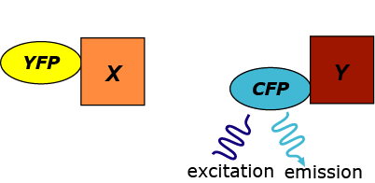
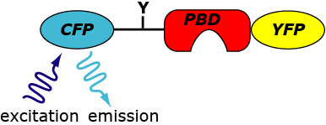
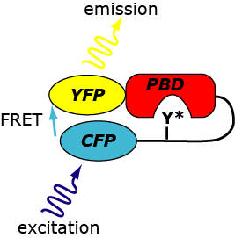
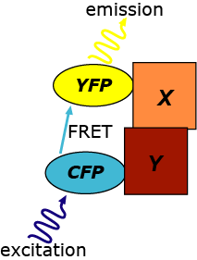
Types of FRET experiments
Intramolecular
Intermolecular

Slide 18
Types of FRET experiments
For intramolecular FRET, CFP and YFP are always present in a 1:1 ratio
Ratiometric imaging can be used as a rough measure of the amount of energy transfer
Intramolecular

Slide 19
Types of FRET experiments
For intermolecular FRET, the relative abundance of CFP and YFP is not controlled and can change over time.
Ratiometric imaging is no longer possible, and additional corrections are necessary.
Intermolecular

Slide 20
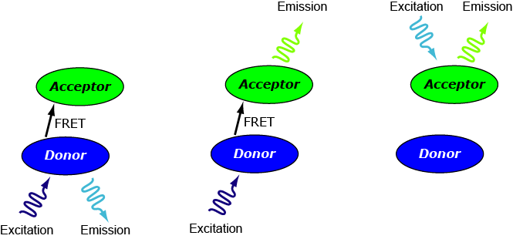
Data Acquisition
Three things to measure:
Donor
Intensity
FRET
Intensity
Acceptor
Intensity

Slide 21
Data Acquisition
Maximize signal-to-noise: use high NA objective, sensitive, low-noise camera, high-transmission filters
Minimize shifts between wavelengths
Fluor or apochromatic objective
Multipass dichroic with external excitation and emission filters

Slide 22
Image preprocessing
Background subtraction
Register images by maximizing correlation with FRET image

Slide 23
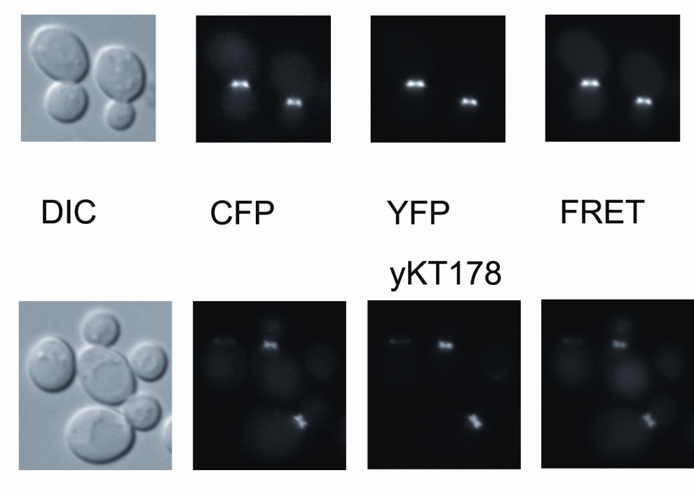
Data Acquisition
Acquire sequential images of FRET, YFP, CFP, and DIC

Slide 24
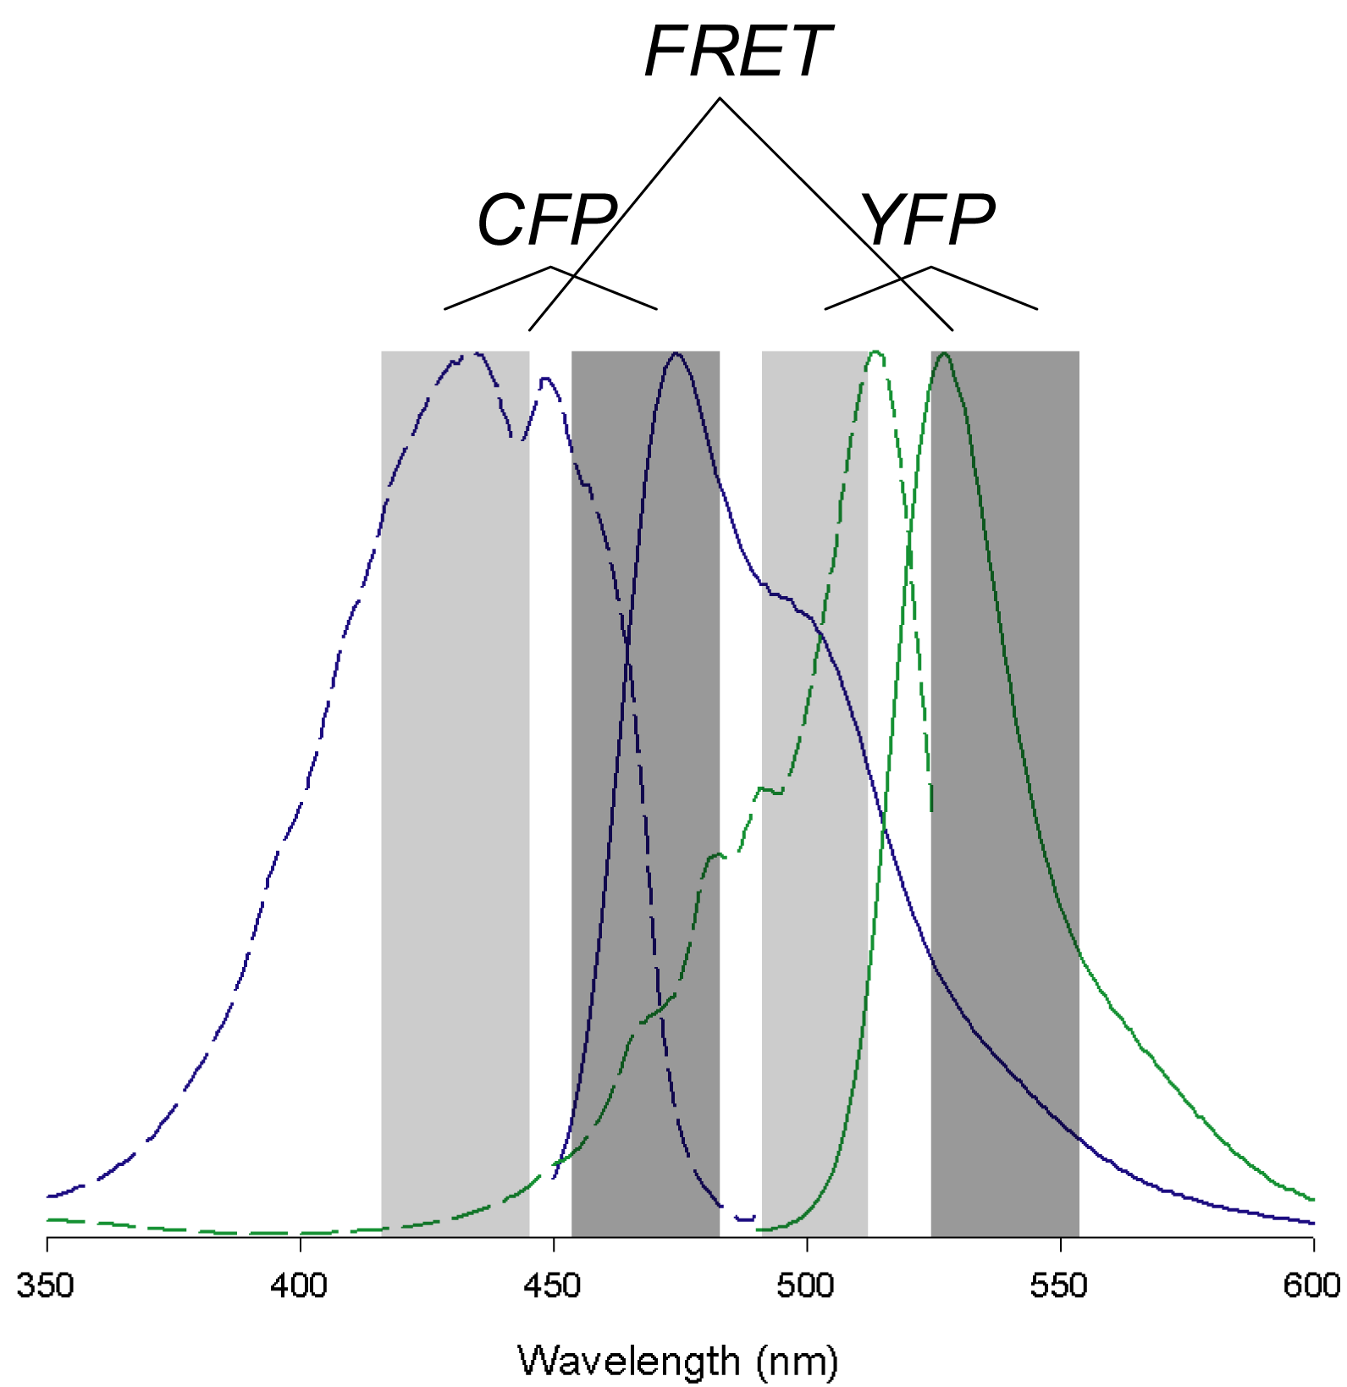
A problem: crosstalk into FRET channel
Correct using measurements from CFP- and YFP- only cells
Ex
Em

Slide 25
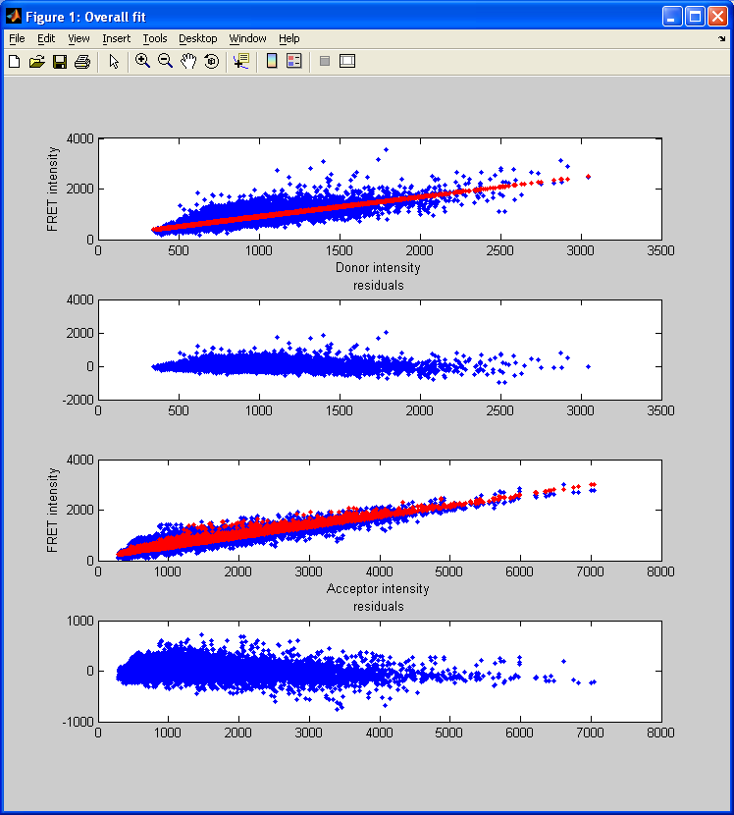
A problem: crosstalk into FRET channel
For strains with only CFP and YFP, FRET_{C} = 0
Fit FRET_{C} = FRET_{m} - αCFP - βYFP - γ
Typical values:
α ~ 0.9
β ~ 0.4

Slide 26

Crosstalk correction

Slide 27
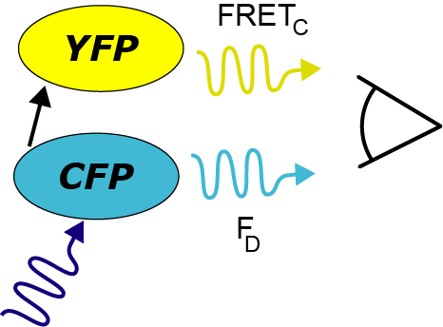
Calculating FRET efficiency
Traditionally:
F_{D} (Donor+Acceptor)
E = 1-
F_{D} (Donor alone)

Slide 28

Calculating FRET efficiency
FRET_{C} · G + F_{D}
E = 1 -
F_{D}
G corrects for detection efficiencies of CFP and YFP
G = Q_{D}Φ_{D} / Q_{A}Φ_{A}

Slide 29
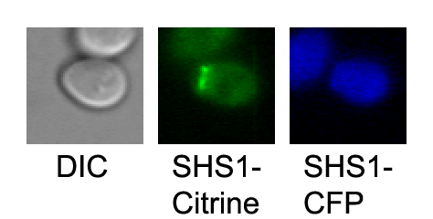
One final issue: Autofluorescence
We correct for autofluorescence in the FRET channel by inclusion of γ
But we also need to correct for autofluorescence in the donor channel
FRET_{C} · G
E =
FRET_{C} · G + F_{D}
Correct donor autofluorescence by subtracting median donor fluorescence of untagged cells

Slide 30
Data analysis procedure
Preprocessed microscopy data
Preprocessing:
Background subtraction
Image alignment by maximizing the correlation of donor and acceptor with the FRET image.
Typical shifts are <2 pixels
Acceptor
only
Donor only
Both colors
Crosstalk
calculation
Corrected
FRET
Calculation of CFP
autofluorescence
FRET
Efficiency

Slide 31
Photobleaching
Some dyes photobleach quite easily (prime offenders: fluorescein, YFP)
Correction procedures are available but are non-trivial
Photobleaching can lead to peculiar artifacts

Slide 32
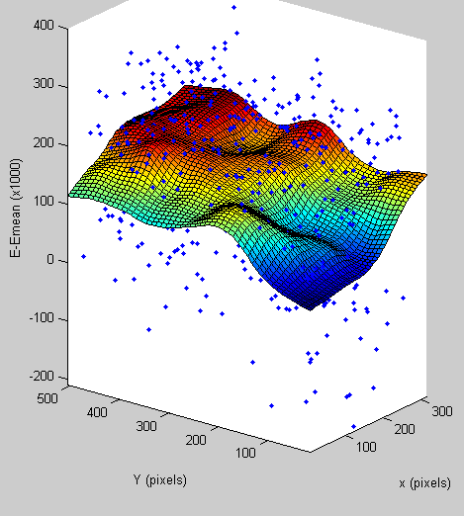
Spatial variation of efficiency

Slide 33
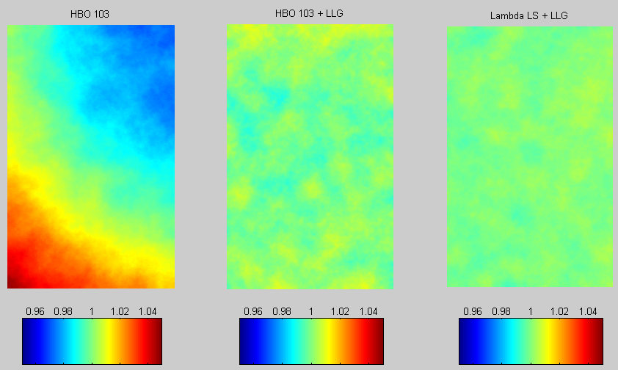
Illumination Uniformity

Slide 34
FRET Conclusions
Using FRET as a qualitative reporter is relatively straightforward.
Quantitative FRET is challenging and requires correction of a large number of potential artifacts.
Trying to use FRET to infer distances in vivo is probably best avoided.
Choice of fluorescent proteins for FRET is likely to be idiosyncratic and system dependent.

Slide 35
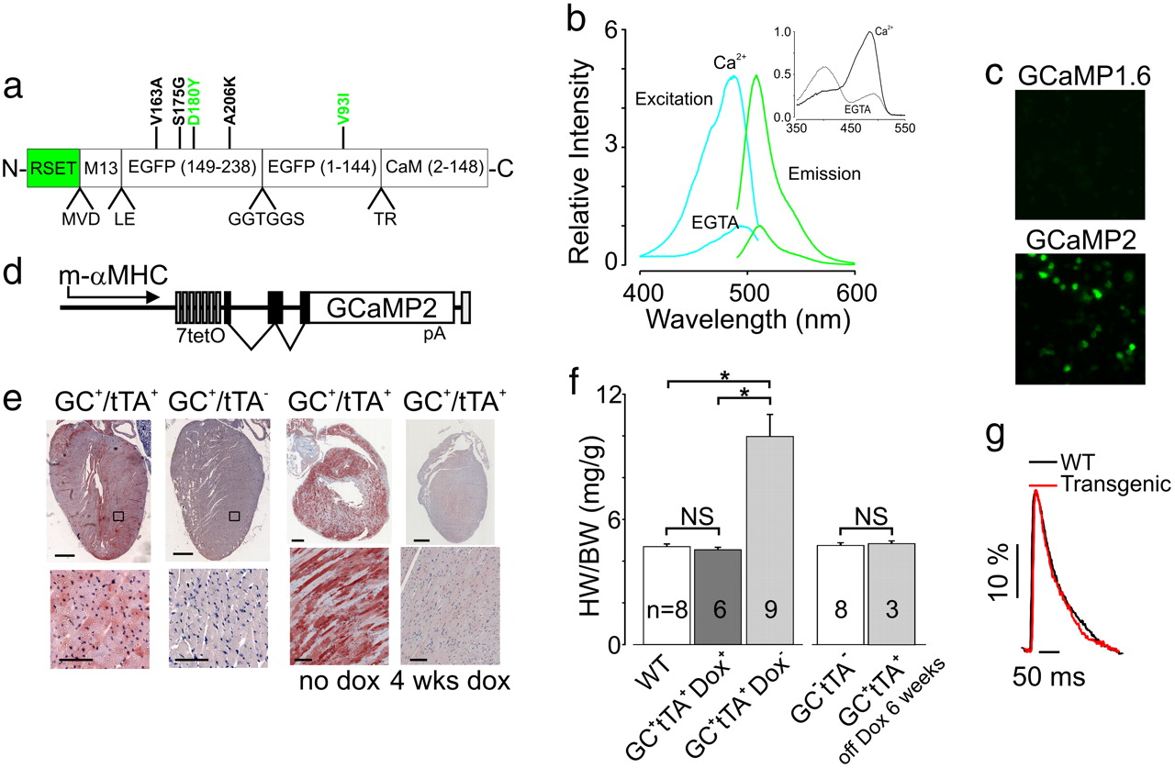
Single domain sensors – GCaMP2
Intensity-based sensor
Tallini et al. PNAS 103: 4753 (2006); Akerboom et al. JBC 284: 6455 (2009)

Slide 36
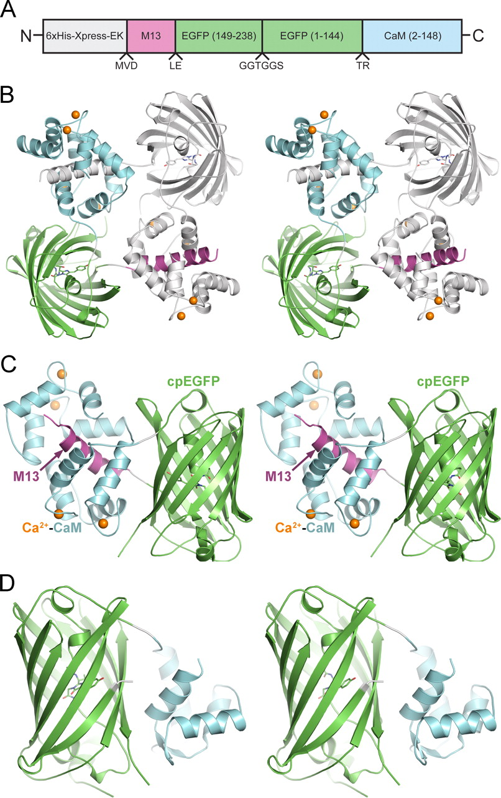
Single domain sensors – GCaMP2
Ca²⁺ bound
Ca²⁺ free
Tallini et al. PNAS 103: 4753 (2006); Akerboom et al. JBC 284: 6455 (2009)

Slide 37
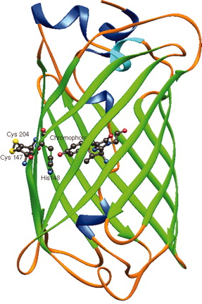
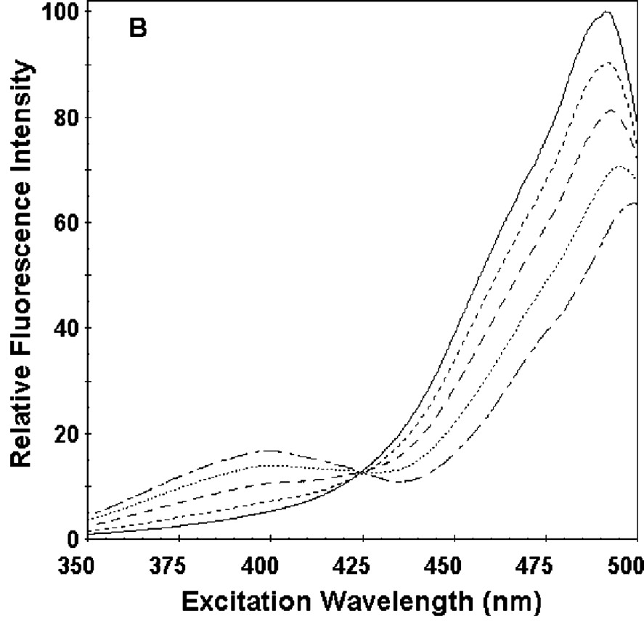
Single domain sensors - roGFP
Ratiometric sensor
Hanson et al. J. Biol. Chem. 279: 13044 (2004)

Slide 38
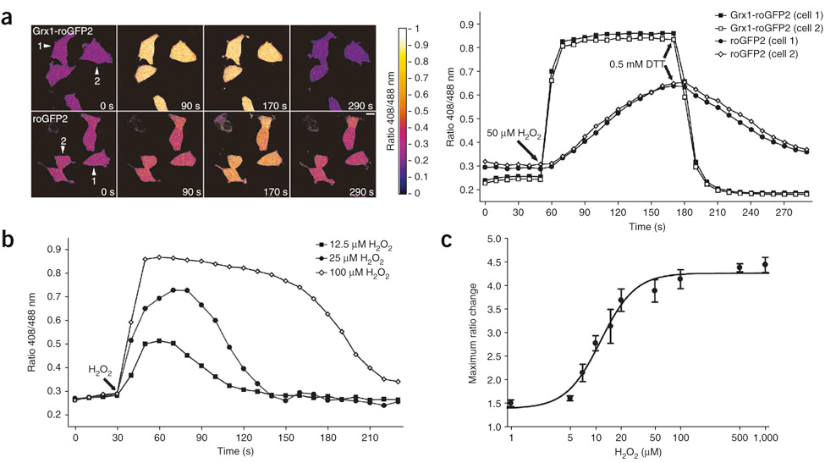
Imaging glutathione redox potential in vivo
Coupling glutaredoxin-1 to roGFP makes it specifically sensitive to glutathione redox potential and accelerates its response
Gutscher et al. Nat Meth. 5: 553 (2008)

Slide 39
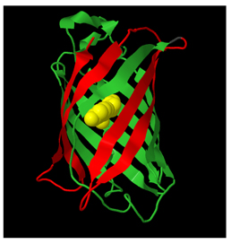
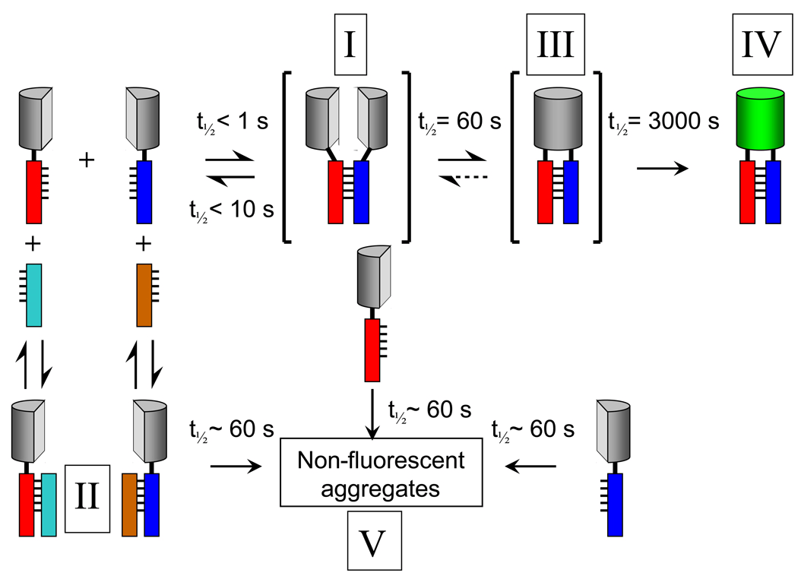
Bimolecular fluorescence complementation
BiFC (aka split GFP)
Has speed and reversibility issues, so most useful as a screening tool.
Kerppola, Annu. Rev. Biophys. 2008, 37: p.465

Slide 40
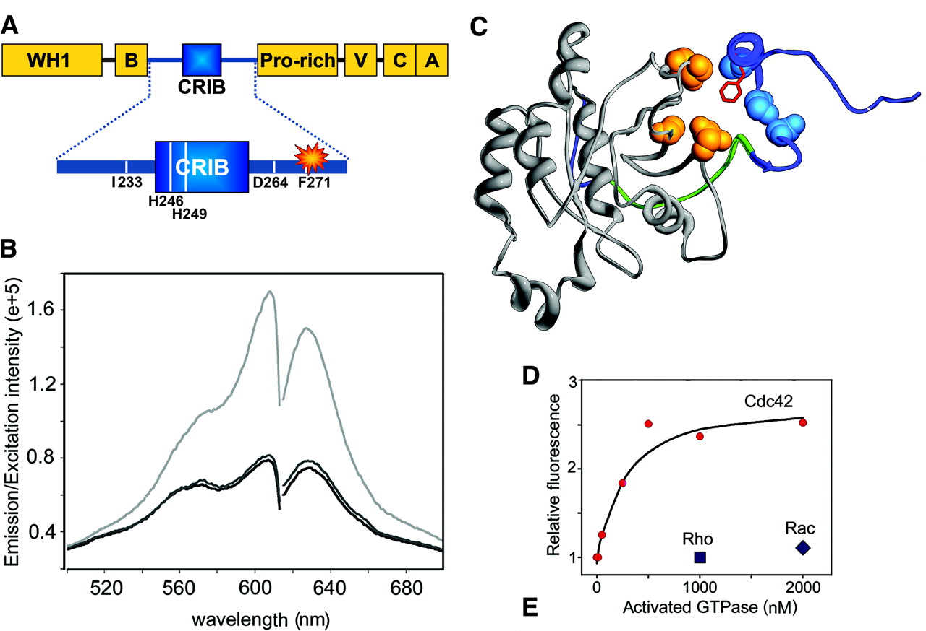
Environment-sensitive fluorophores
Cdc42-binding domain of WASP as sensor for active Cdc42
I-SO
Nalbant et al. 2004, Science 305: 1615-1619

Slide 41
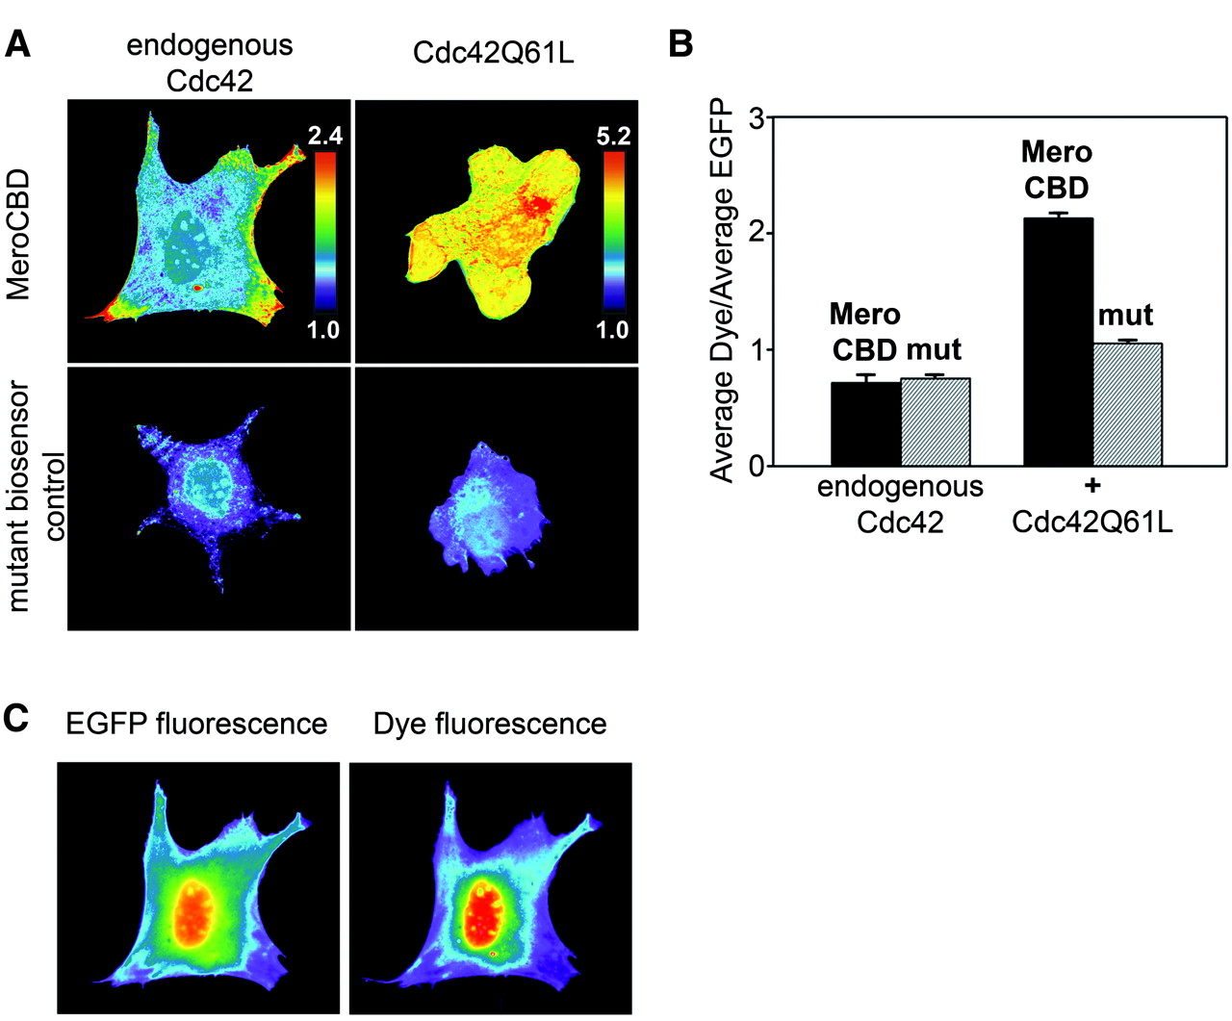
Imaging Cdc42 activation
Fuse sensor to GFP; I-SO/GFP ratio is proportional to degree bound

Slide 42
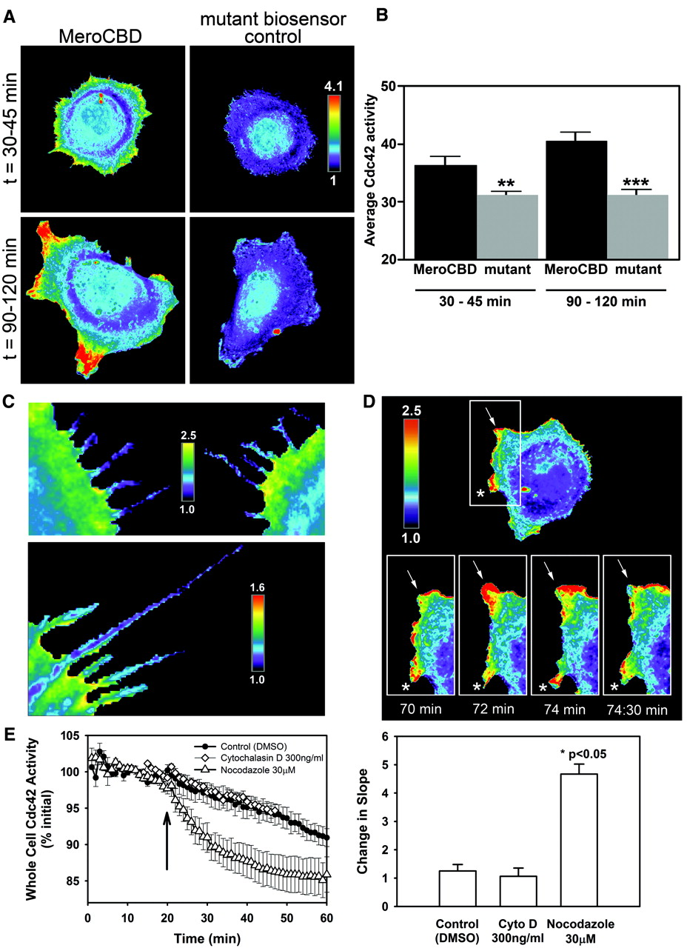
Monitoring Cdc42 activation

Slide 43
Additional reading
Lakowicz, “Principles of Fluorescence Spectroscopy”, Chapters 13-15
Gordon et al. 1998, Biophys. J. 74 p. 2702-2713
Berney and Danuser 2003, Biophys. J. 84 p.3992-4010
Zal and Gascoigne 2004, Biophys. J. 86 p 3923-3939
FRET code is at: https://github.com/kthorn/fretproc

